Slide 1
How much light hits the ocean surface?
Energy [Watts/m^2]
Energy is conserved! Form can change, but can’t go away.
Quanta [Moles/(m^2 s)]
Photosynthesis is quantum! E=hc/λ be damned
Fixing 1 CO2 requires 8 photons of 700nm or less
PAR [Quanta within 350-700nm]
Number of Photosynthetically viable photons
Characteristic Scales: [uMoles/(m^2 s)]
Noon, clear sky 10^3
Noon, cloudy 10^1
Full Moon, clear 10^-3
New Moon, clear 10^-6
Cloudy Night 10^-8

Slide 2
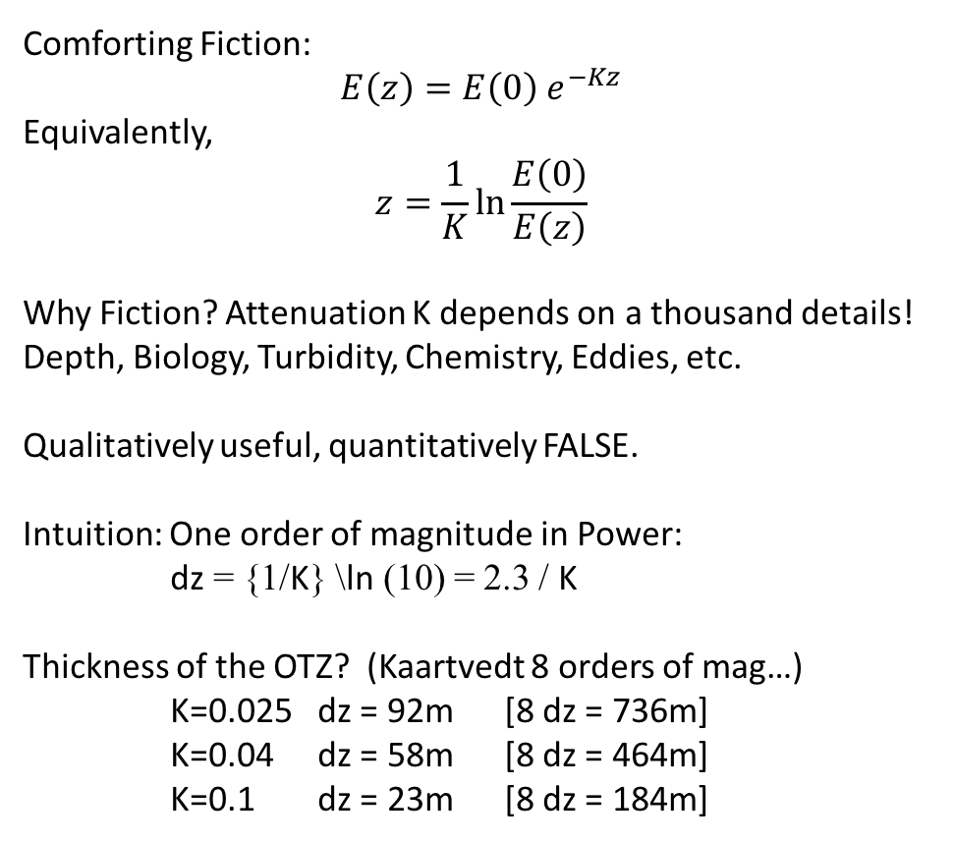
How much light makes it to the deep?
Comforting Fiction:
$$E\left(z\right)=E\left(0\right) e^{−Kz}$$
Equivalently,
$$z=\frac{1}{K}\ln{\frac{E\left(0\right)}{E\left(z\right)}}$$
Why Fiction? Attenuation K depends on a thousand details! Depth, Biology, Turbidity, Chemistry, Eddies, etc.
Qualitatively useful, quantitatively FALSE.
Intuition: One order of magnitude in Power:
dz = {1/K} \ln (10) = 2.3 / K
Thickness of the OTZ? (Kaartvedt 8 orders of mag…)
K=0.025 dz = 92m [8 dz = 736m]
K=0.04 dz = 58m [8 dz = 464m]
K=0.1 dz = 23m [8 dz = 184m]

Slide 3
How did all this light get so deep?
(Li et al, 2014, 2016)
L = L_T + L_E + L_I + L_S
Key takeaways:
Absorption depletes photons (familiar exponential)
Elastic scattering (Ei = Ef) softens the angular distribution
Inelastic scattering (esp Raman, also Fluorescence from Chlorophyll & CDOM) transports blue to green and red!
IES: Green and Red run symmetric in the deep!
Sources in the deep (bio, K40) eventually dominate
Euphotic zone dominates surface irradiance!
➔ We must measure radiance IN SITU!!
Spectrum
Angular distribution
Spatial and temporal structure

Slide 4
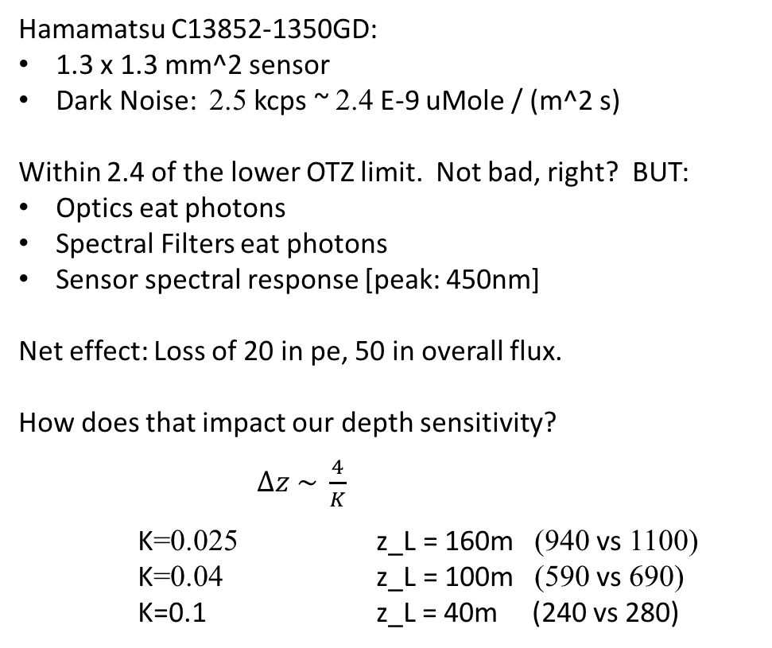
Why Our Sensor?
Hamamatsu C13852-1350GD:
1.3 x 1.3 mm^2 sensor
Dark Noise: 2.5 kcps ~ 2.4 E-9 uMole / (m^2 s)
Within 2.4 of the lower OTZ limit. Not bad, right? BUT:
Optics eat photons
Spectral Filters eat photons
Sensor spectral response [peak: 450nm]
Net effect: Loss of 20 in pe, 50 in overall flux.
How does that impact our depth sensitivity?
$∆z \sim \frac{4}{K}$
K=0.025 z_L = 160m (940 vs 1100)
K=0.04 z_L = 100m (590 vs 690)
K=0.1 z_L = 40m (240 vs 280)

Slide 5
The speed of an isolume: a shrimp's eyeview
Widder & Frank (2001)
There are two leading hypotheses as to what aspect of the light field is triggering DVM migrations.
1) "rate of change" hypothesis: migrations are triggered by the rate and direction of change in light intensities.
2) "preferendum" hypothesis, suggests that animals remain within a preferred light zone, known as an isolume.

Slide 6
Enlightening the ocean’s twilight zone
Kaartvedt, Langbehn, & Aksnes (2019)
Table 1. Hypotheses related to the ocean twilight
1) Light exposure of the daytime DSL is largely similar between geographic regions.
Measure mesopelagic light and extend the geographic coverage of observations to include very clear and very murky waters.
2) Light exposure during day and night is comparable in vertically migrating organisms.
Establish ambient wavelength resolved light measurements for day and night.
3) Light climate in polar regions hampers success of mesopelagic fish.
Establish DSL distribution and its components relative to photoperiod (latitude). Assess under-ice light environment.
4) Trophic transfer efficiency from phytoplankton to mesopelagic fish is particularly high in clear oligotrophic oceans.
Add water clarity as factor in studies of trophic structure and production.
5) Hypoxia results in darker waters with an upward shift in the twilight zone causing shallower distribution of the DSL.
Measure transparency relative to hypoxia. Assess the hypothesized association between hypoxia and CDOM.
6) Light conditions (water clarity) determine depths of mesopelagic microbial hot spots.
Assess microbial processes relative to vertical DSL distributions along gradients of water clarity.

Slide 7
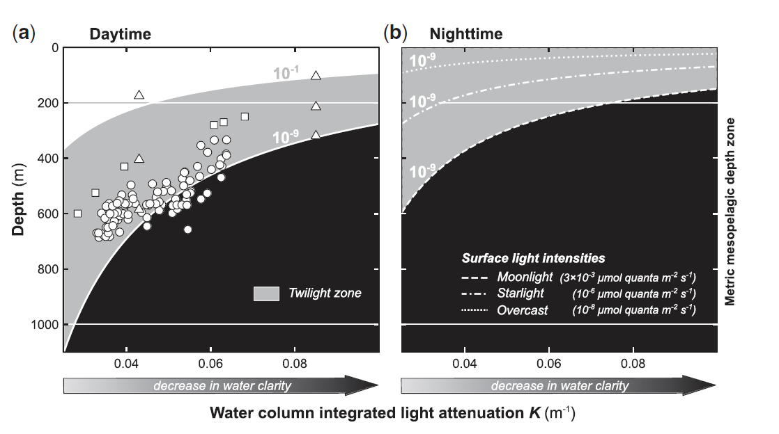
Light Comfort Zone
Figure 1. The vertical extension of the twilight zone, defined as the depth interval where the light intensity is between 10-9 and 0.1 mmol quanta m-2 s-1, at daytime (a) and night-time (b) as a function of water column light attenuation. Daytime surface light intensity is assumed to be 1000 mmol quanta m-2 s-1.
Daytime data points correspond to the mean depth of the sound scattering layers reported for the circumglobal Malaspina Expedition (circles), for regions in the North Atlantic and Gulf of California (squares), and for three different vertical sound scattering layers in the Red Sea and Masfjorden (triangles).

Slide 8
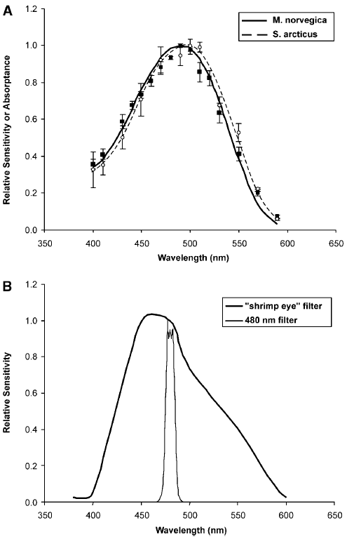
The speed of an isolume: a shrimp's eyeview
Widder & Frank (2001)
A Spectral sensitivity of the euphausiid Meganyctiphanes norvegica (solid line) and the sergestid shrimp Sergestes arcticus (dashed line) as measured by electroretinogram.
B Spectral responsivity of the LoLAR with the ``shrimp filter'' in place (thick line) as compared with the 480 nm interference filter in place.
LoLAR = low light auto-radiometer.

Slide 9
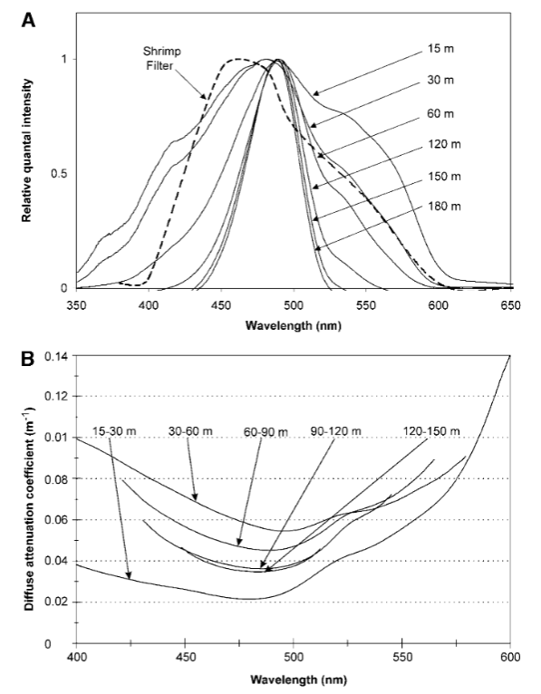
The speed of an isolume: a shrimp's eyeview
Widder & Frank (2001)
A Variation of spectral distribution of downwelling light with depth in Oceanographer Canyon, as measured with fiber optic spectrometer from the submersible. The dashed line is the spectral responsivity of the LoLAR with the "shrimp filter'' in place.
B Variation of diffuse attenuation with depth in Oceanographer Canyon, calculated over the indicated depth intervals. The decreasing width of the plotted spectra with increasing depth is a consequence of the loss of a measurable signal at short and long wavelengths.

Slide 11
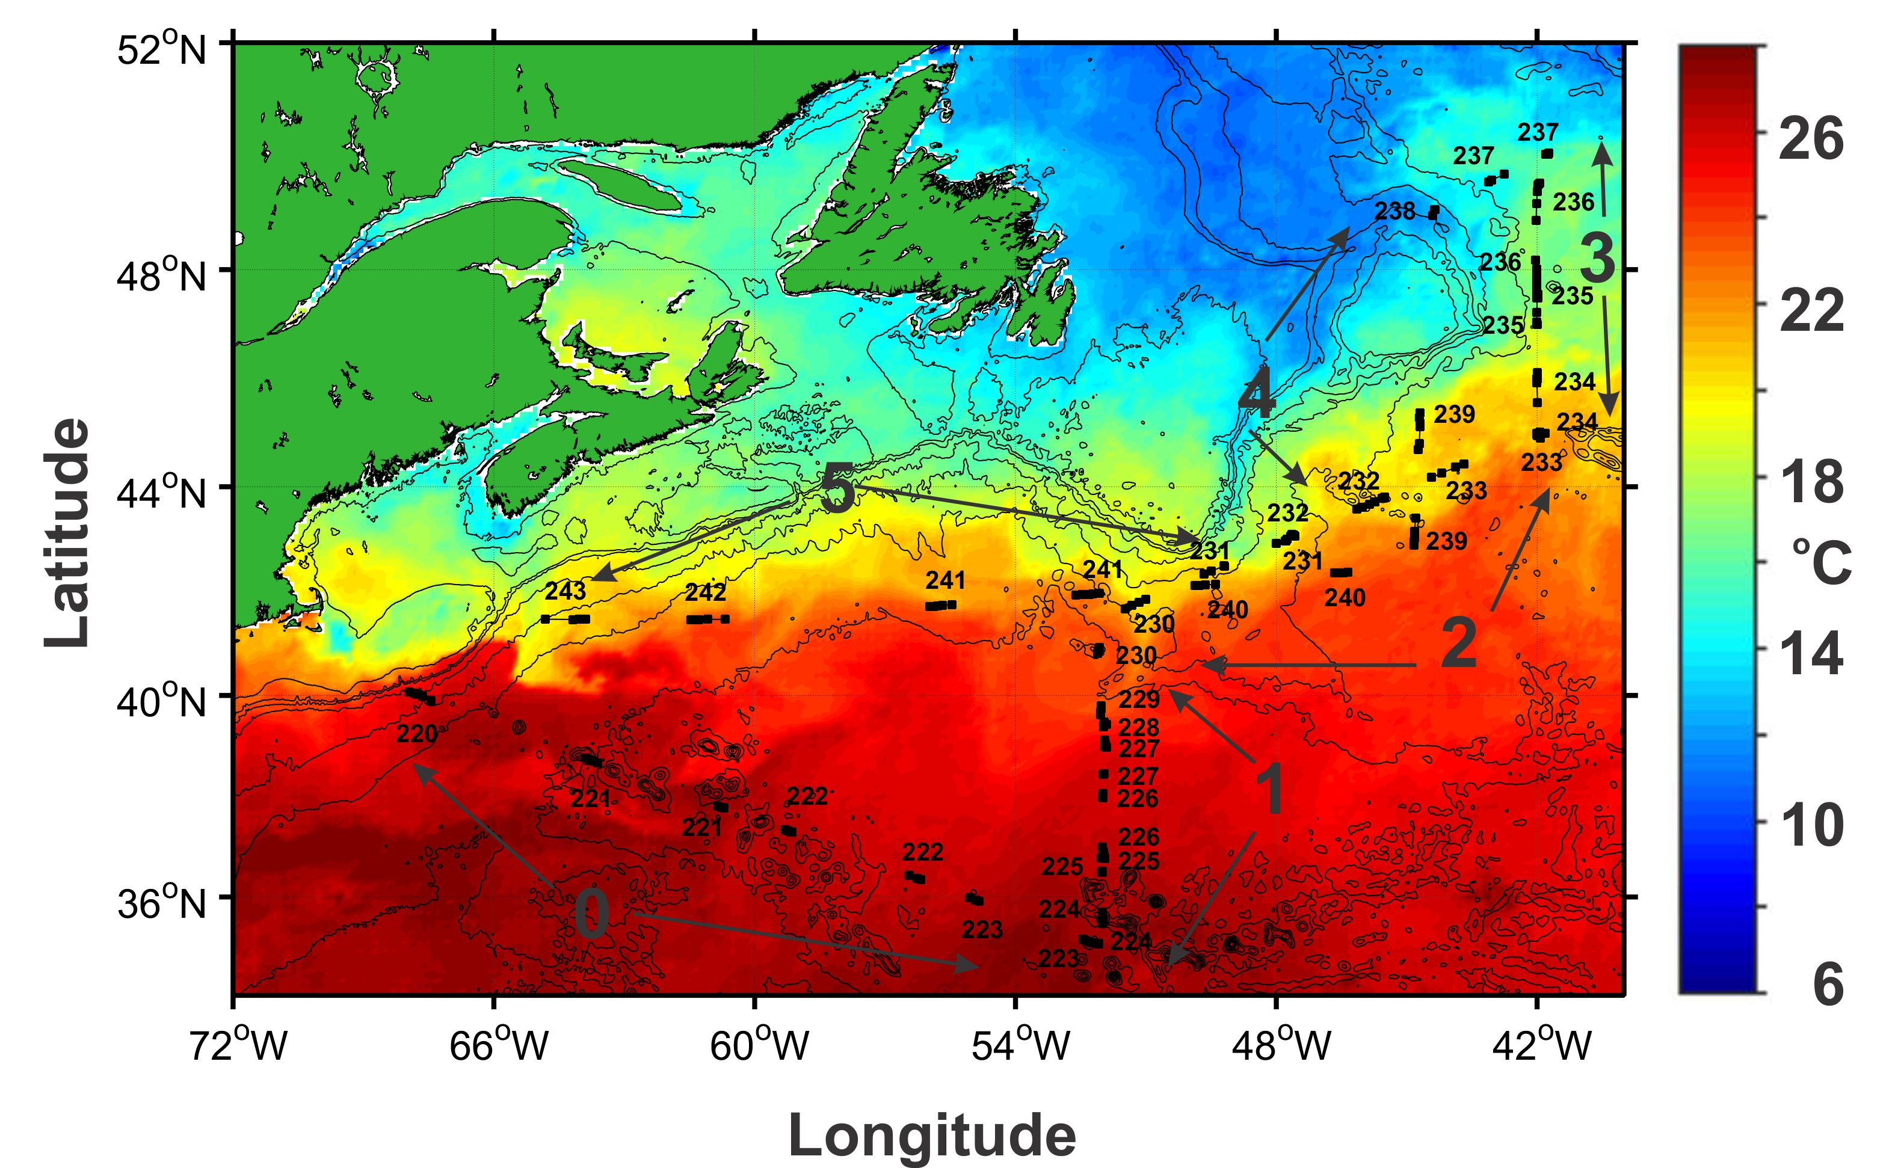

Slide 12
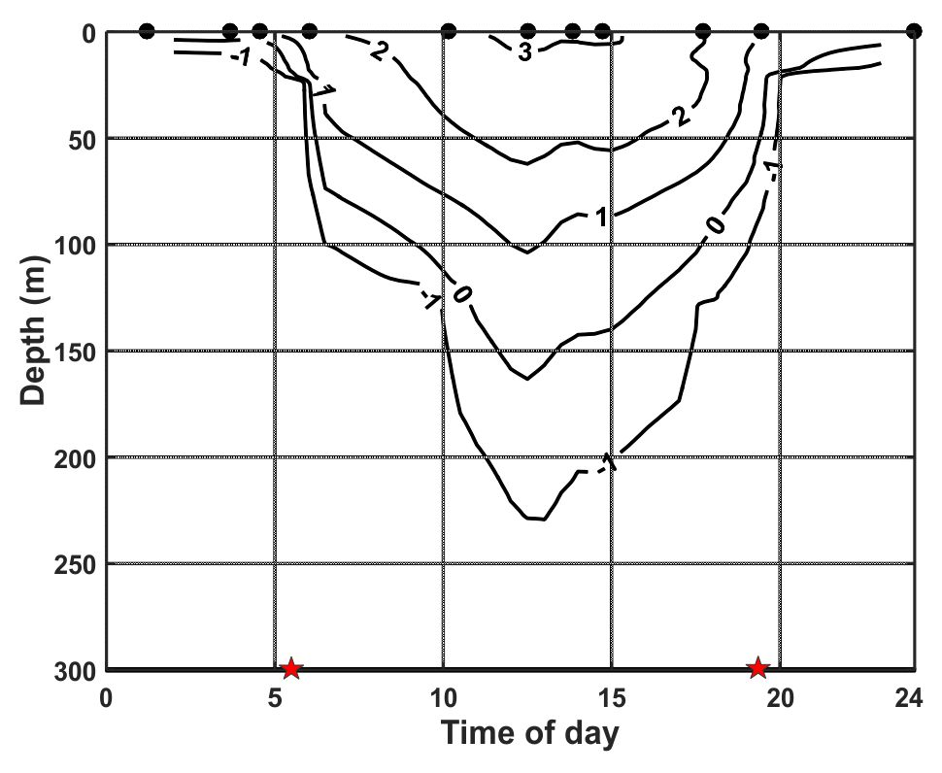

Slide 13
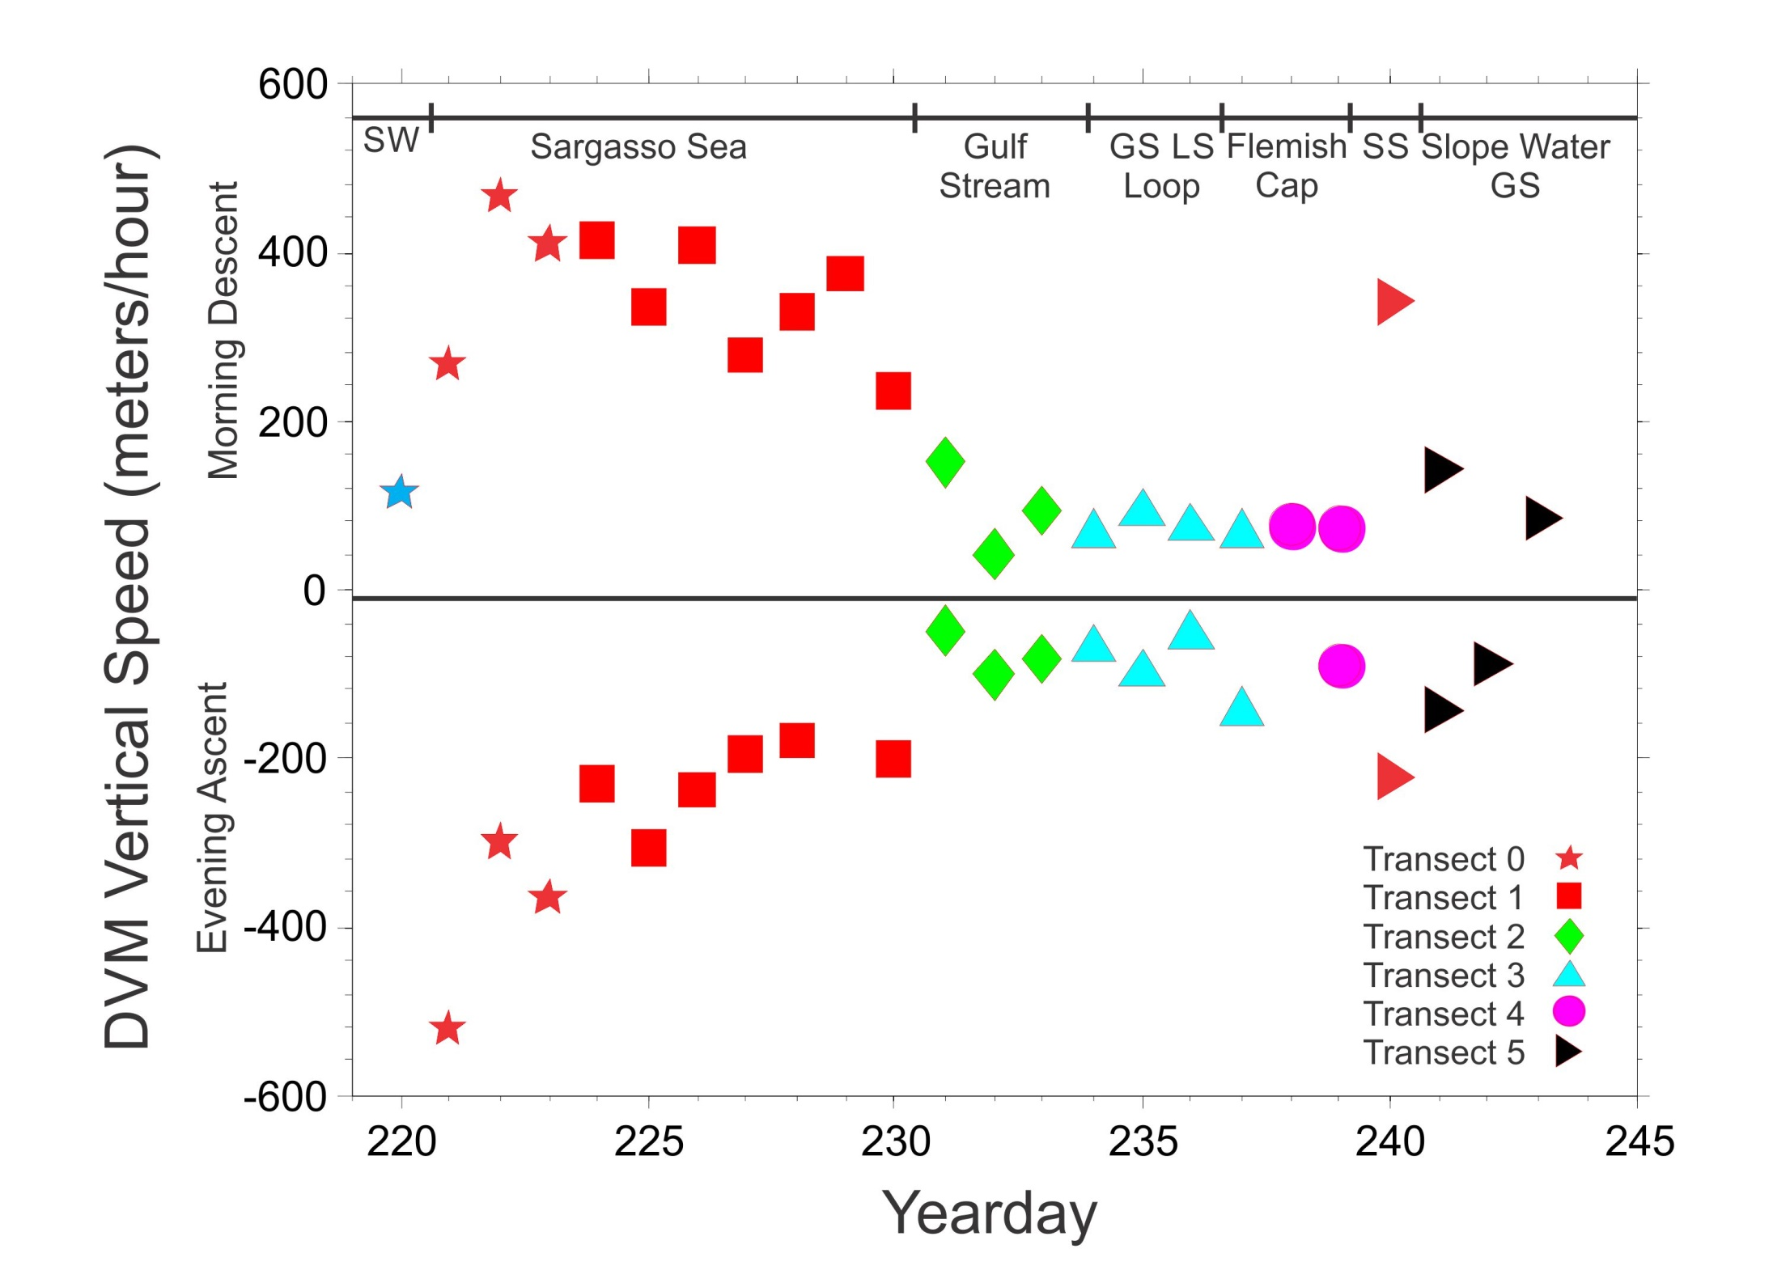

Slide 14
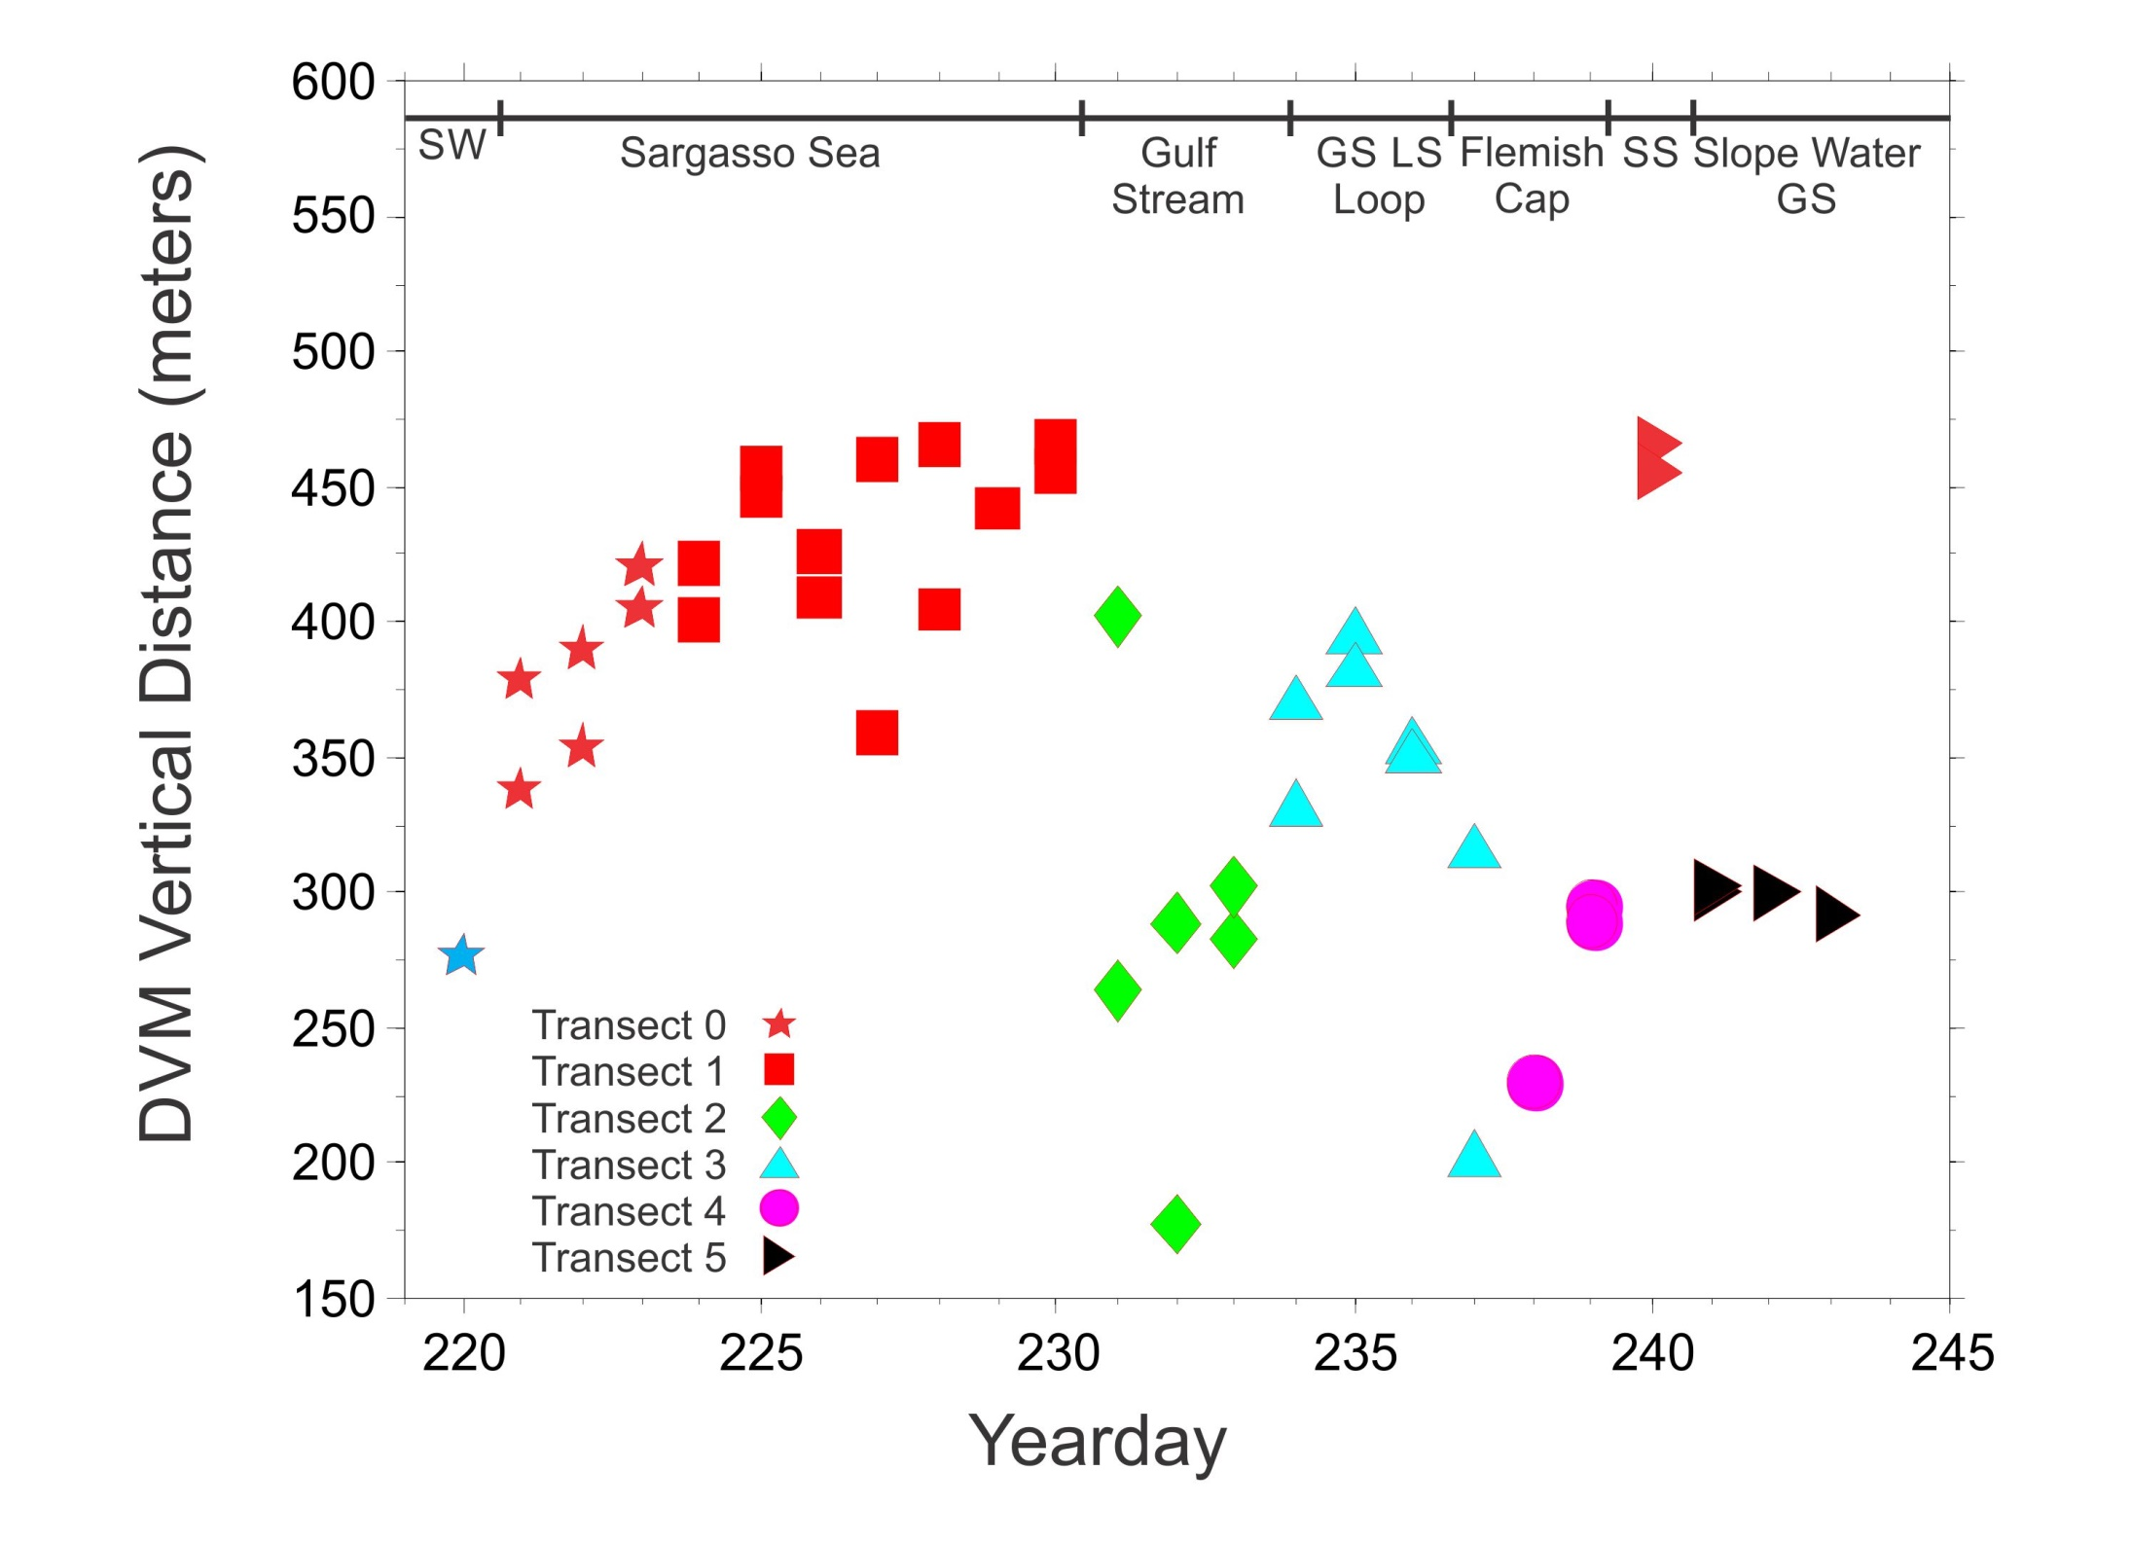

Slide 15
